Slide 1
Semi-automated knowledge graph creation Overlaps between AI and Data Management Data Management Community Call
Tim Kettenacker
Gul Jabeen
November 22nd 2019

Slide 2
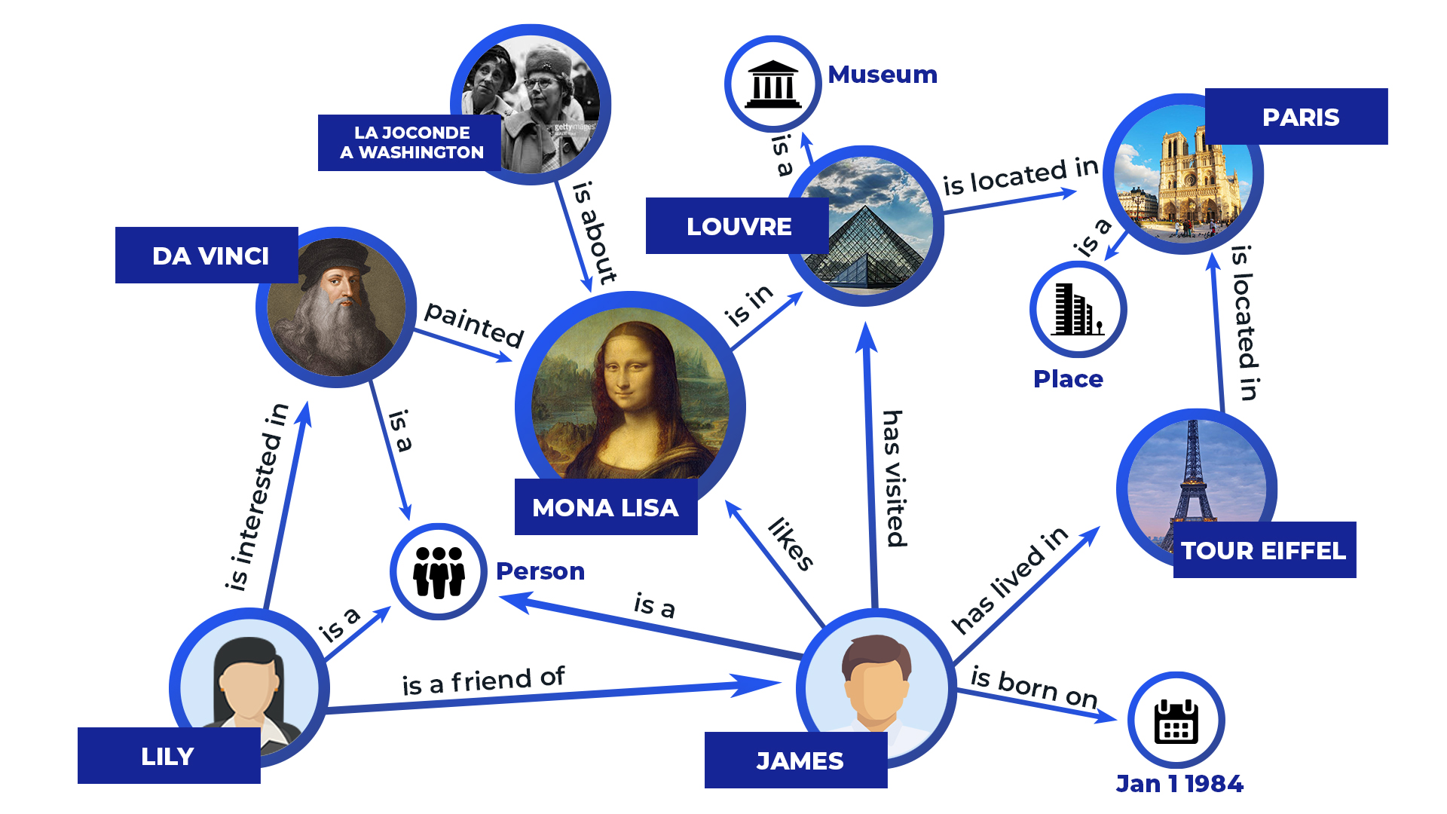

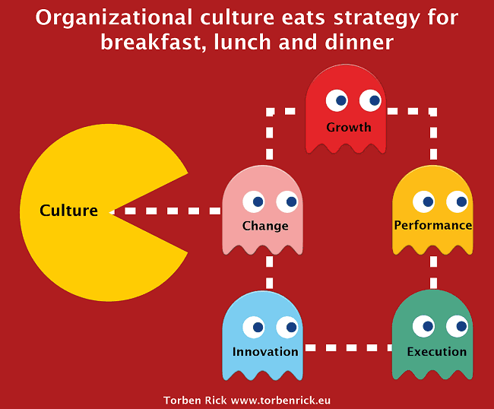
Promises of knowledge graphs ...
Searchable by laymen terms
Information at the fingertips
Easily extendable
… and implementation reality
Organizational adaption is slow, time consuming manual content generation
Time intense tasks should be speed up, but not at the expense of quality

Slide 3
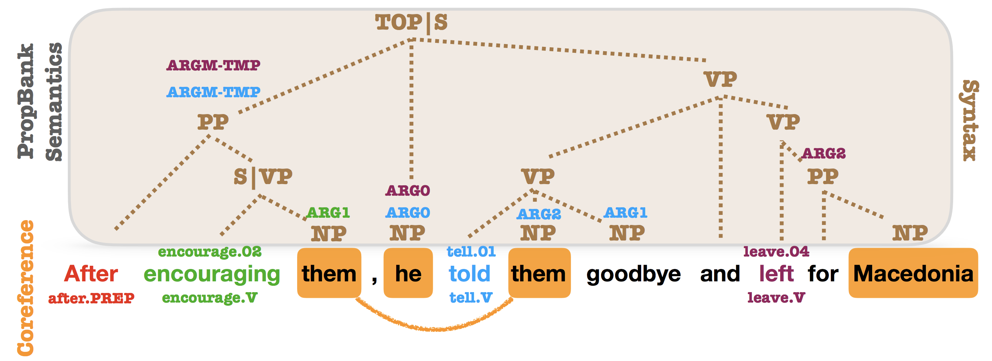
NLP speeds up the (mostly tedious) creation of a knowledge graph
Usually, companies already have written down their domain knowledge in one way or the other:
Confluence
Jira
Plain old word document
…
Ontology Creation
Deep Learning
Semantic Annotation
Data Management
Natural Language Processing
It is possible to extract and transform information into a form needed for modelling knowledge graphs by means of artifical intelligence! Our project operates at the brink between AI and data management …
Data Science / Artificial Intelligence
Sentiment Analysis
Data Discovery
Data Governance

Slide 4

















Every corporate AI project is closely intertwined with information management
In the current AI wave, it is all about automating repetitive work for a specific domain.
The sponsors for AI solutions are business players that are fed up with slow IT departments and prefer to work in a self-service fashion.
What is the business question AI should support?
Is the data fit for my purpose?
How to make the results consumablefor others?
Where is the data I can use for training my models?
Which model to chose?
Integration needs?
Data usage?
How to present the information?
Lifecycle information?
„Make“ or buy?
DataOps support?

Slide 5

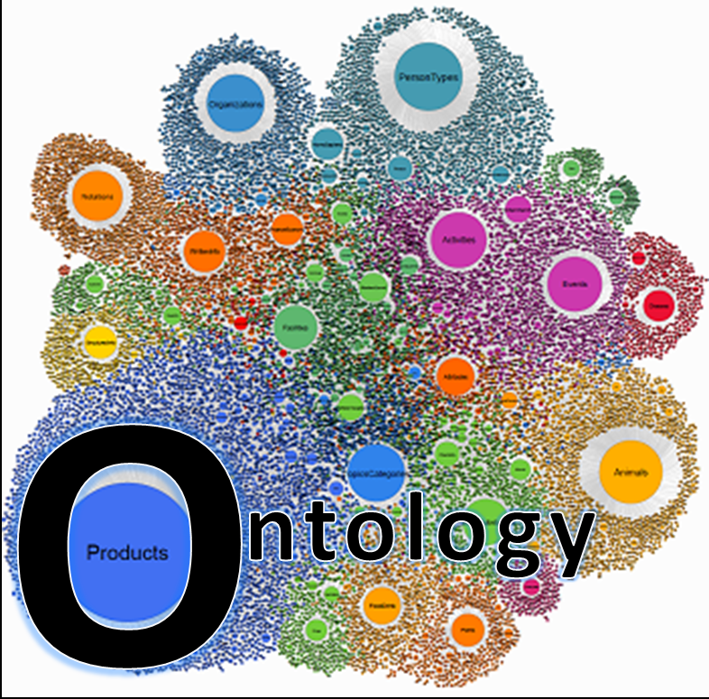
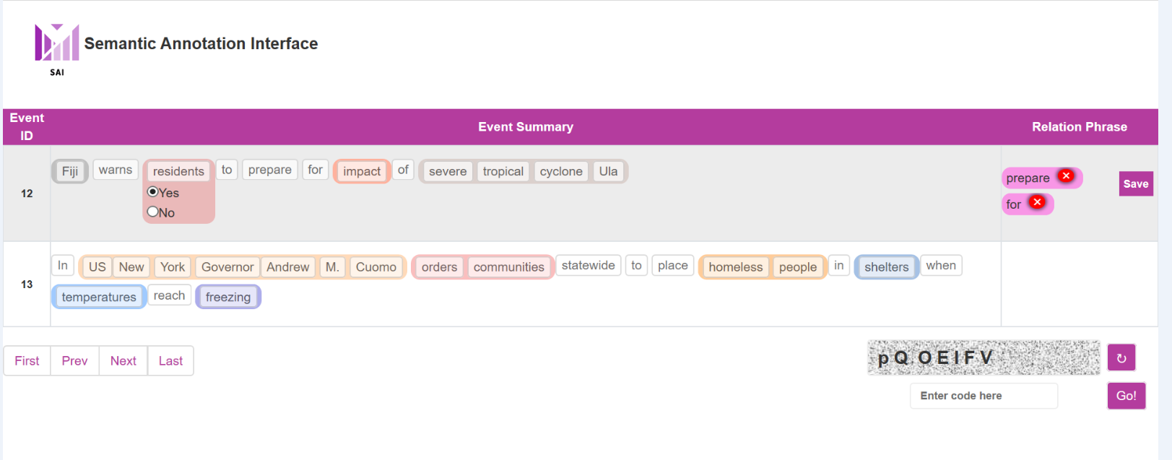
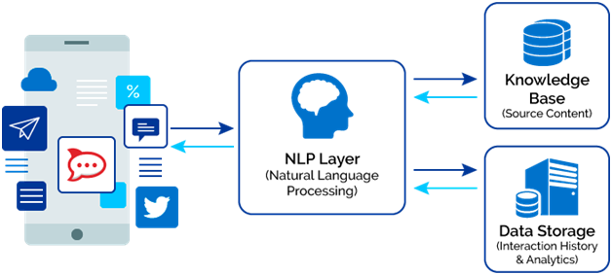


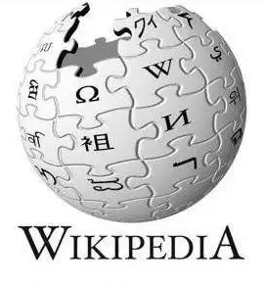
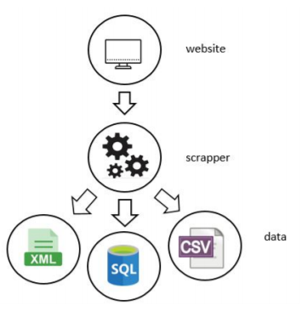
How can we convert unstructured data to structured data?
SEC1
1
5
Data Scientist
Data manager
Data Engineer
3
Business
How to convert unstructured into structured data?
Insurance company tries to monitor real-time events to figure out how it affects investment objects
Storage of (intermediate and end) results
Triples
Where is the data for training this model?
Data Scientist/
Data Manager
2
Crowdworkers
Review Annotated Objects
Data Manager/Domain Expert
4

Slide 6
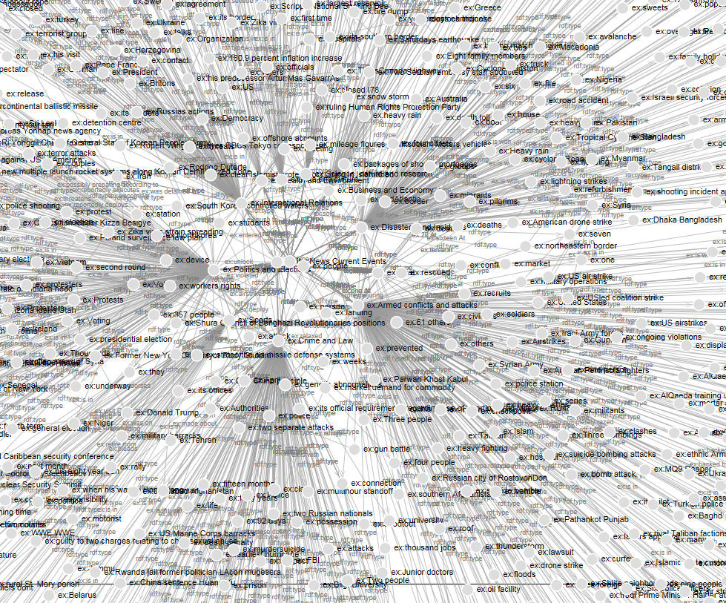
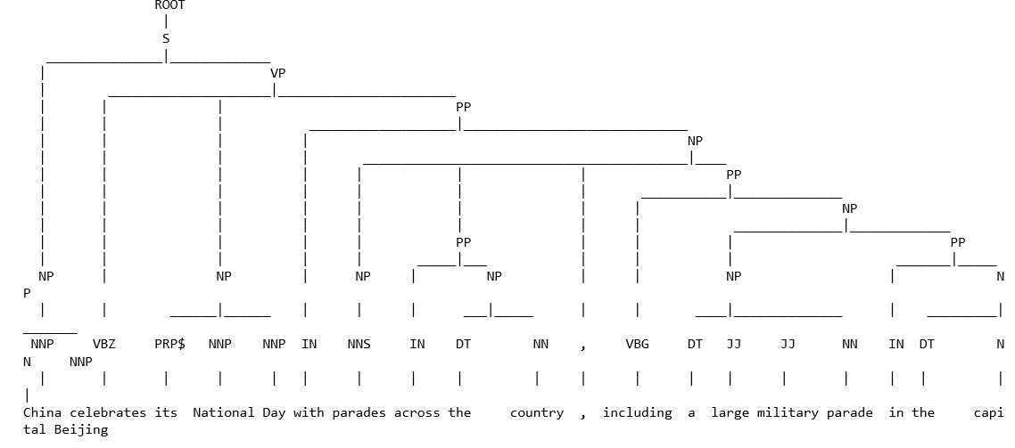
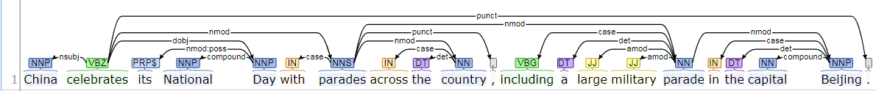
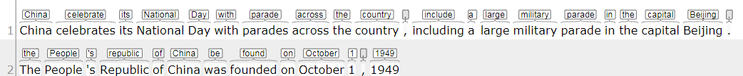
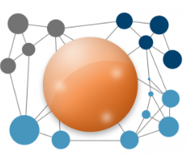
Architecture & Examples
SEC1
Sarah travels to the UK.
Sarah is going to the UK.
Sarah went to the UK.
Sarah travelled to the UK.
I am travelling to Germany
travel travel 1.0
travel going 0.17055118
travel went 0.044150226
going travel 0.17055118
going travelling 0.69
Semantic Annotation
Ontology Creation
Location(Meta Data)
Data Preparation
Word Tokenization
Similarity
Sentence Splitting
Part of Speech
Named Entity Recognition
Meta Data Creation
Triples Generation
Human Ontology Formalization
Annotation Object
Human Annotation
Word Embedding
Web scrapper
Name Entity Recognition
Unstructured data
Data Cleaning
Shallow Parsing
(Bi)Relation Extraction

Slide 7











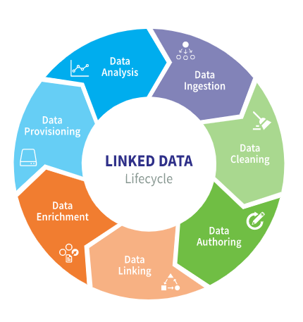




Knowledge Graphs for Better Data Management
Hello What is my task here?
We need to validate extracted information.
Don’t rely on machines
SEC1
Annotation tools are required by developers so as to better configure the quality and consistency of the results.
Data Manager
Data Manager
Human Inteligence
Data Manager
Relational Databases
Meta data feedback into content extraction
Convert to rdf and adds meta data
Unified rdf storage with meta data
Unified interface
User Acesses one interface
Content management systems
Information Extraction
I am providing all data and content based on domain and client‘s requirements
Upload rdf data
Data Scientist
Text in any format
I will take care of it
Data Manager
Companies store lots of text (documentation, wikis etc.). A multitude of related documents could be used to support creation of domain-specific ontologies.
Now we have rich and smart data.

Slide 8
Findings
if we want to measure the success of automatic creation of knowledge graphs through NLP, we need a human factor as a benchmark - so what defines a good knowledge graph?
correct identification of domain
accuracy of naming for entities and relationships
quality of derived relations
high breadth and depth of entity and relationship variance (“nested” constructs, amount)
reuse of existing vocabulary (being used in other knowledge representations on the web)
while NLP APIs are becoming more and more versatile in recognizing peculiarities in human language, human guidance is needed
Does it shift the role of a data manager?
point & provide
validate & correct
Data Manager
Data Strategist
domain expertise
…
Retrieval patterns

